Slide 1
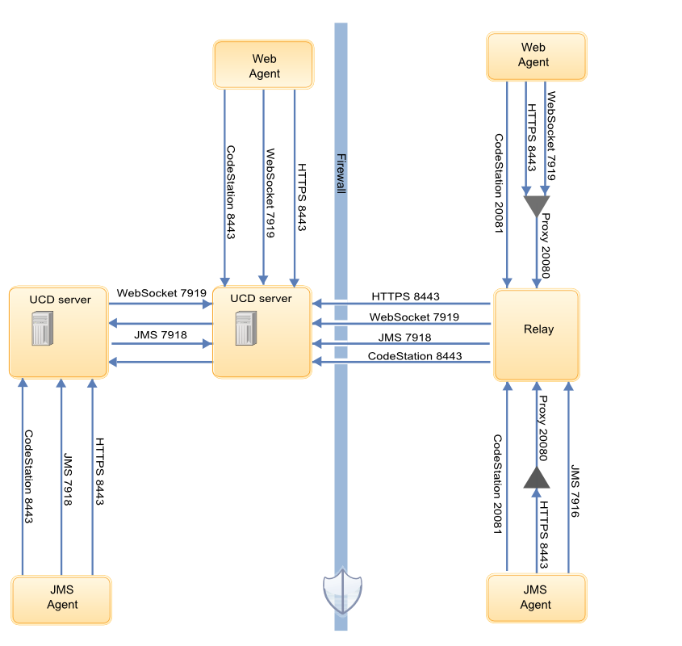
RFE Passive Relay - Definition
Normal Relay
This is the way it works in Urban Code Deploy
=> Normal relays are unacceptable for the security
Passive Relay
Request For Enhancement
=> Passive relays are acceptable for the security

Slide 2
RFE Passive Relay - Key benefit
ORGANIZATION
critical VLAN
CLOUD
exposed VLAN
The connexion is iniated by UCD server
The Firewall is configured for outbound streams (8443 7919 7918)
The present and passive relays differ only at the first connexion with UCD server
Once connected, the passive relay is fonctionning exactly as a normal relay.
Passive Relay

